Slide 1

Computer Application
Class IX

Slide 2

Topic
Package
Exception
Wrapper Class
String
StringBuffer
Stream
Util
Surprise
Summary

Slide 3
Package
It is mechanism for organizing java classes
Example :
import java.util.*;
import javax.awt.*;
import javax.swing.*;
import java.io.*;
import java.lang.*;
import java.net.*;
import java.applet.*
Explanation:
util – Utilities in Java (Date,Scanner,etc)
awt,swing – GUI(Grpahical User Interface)
io – Input/Output Operation
lang – Language package
net – Networking operation
* - Includes all the classes in the package

Slide 4
Guided Practice
1) Create a User defined package
Rule
Package name should not be reserved keyword or numbers
import keyword should be used to import package
STEP I – Create Folder with name as mypackage
STEP 2 – Save myclass.java file in mypackage folder
STEP 3 – Create testpackage.java and save it outside of mypackage folder
Example:
//Save filename as myclass.java
package mypackage;
public class myclass
{
}
//Save as testpackage.java
import mypackage.*;
public class testpackage
{
public static void main(String a[])
{
myclass c = new myclass();
}
}

Slide 5
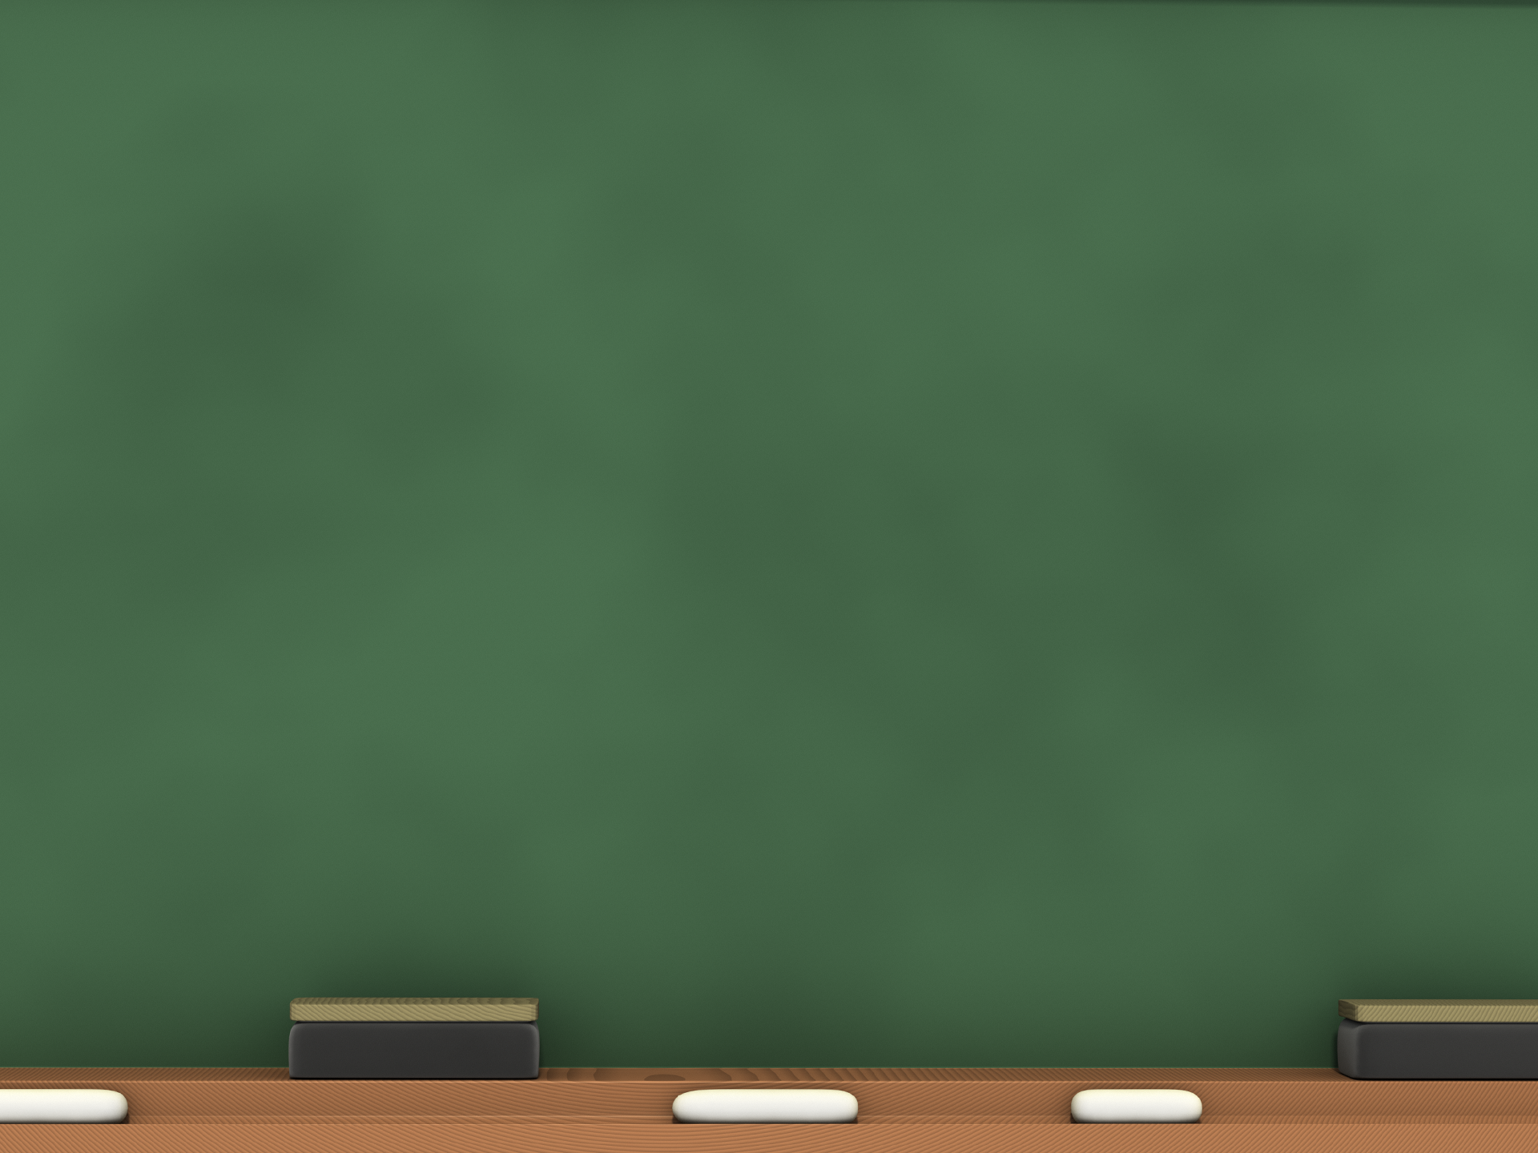
Exception
It is a runtime error, occurred by JRE during execution of program
Error:
Compilation Error
Runtime Error
Precaution:
try..catch block (Exception Handling)
throws
Advantage:
Separates normal and error handling code
More Readabilty
Robust,fault-tolerant program

Slide 6
Exception(Contd…)
When to Use:
Complex Arithmetic Calculation
I/O File Operation
Unpredictable User I/O
Syntax:
try
{
//Error Code
}
catch(Exception e)
{
//Exception Message
}
finally
{
//always run code
}
try block
exception block
finally block
(Optional)

Slide 7
Exception(Contd…)
Example:
StringFormatException
Exception
NumberFormatException
FIleNotFoundException
ArithmeticException
NullPointerException
ArrayOutofBoundsException
IOException
Code:
int a=10,b=0,c;
try
{
c=a/b;
System.out.println(“Output” + c);
}
catch(Exception e)
{
System.out.println(“Wrong Input”);
}
finally
{
System.out.println(“See you again Bye!!” );
}

Slide 8
Exception(Contd…)
Rules:
Each try should have one catch mandatory
Each try can have more than one catch block
catch block get executed, when there is an exception
finally block is optional and executed regardless of exception
Usage of throw
Used to raise an custom message with predefined Exception
Used to force an exception in the program
Used inside the method
Used along with try..catch block
Usage of throws:
use to raise specific exception
used in method level (e.g in main Method)
can be used without using try..catch block

Slide 9
Exception(Contd…)
Example:
import java.util.*;
Import java.io.*;
public class Notepad
{
public static void main(String args[]) throws IOException
{
Runtime rs = Runtime.getRuntime();
rs.exec(“C:\\Windows\\notepad.exe");
}
}

Slide 10
Wrapper Class
Part of Java standard library java.lang and convert predefined data types in to object or class variable.
Easy to convert datatype(e.g string to number and number to string)
Predefined Data Types
boolean
char
byte
short
int
long
float
double
string
Wrapper Class
Boolean
Char
Byte
Short
Int
Long
Float
Double
String

Slide 11
Wrapper Class(Contd…)
Three ways to work with Character data
Character
It will hold single character,value enclosed in single quotes
String
it is immutable and size cannot be modified and value enclosed in double quotes
Any change in string will create a new copy and will be attached to the string
StringBuffer
it is mutable and size can be modified
Predefined Data Types
boolean
char
byte
short
int
long
float
double
string
Wrapper Class
Boolean
Char
Byte
Short
Int
Long
Float
Double
String

Slide 12
Wrapper Class(Contd…)
e.g for String:
String a =“abcd 123”;
String a = new String(“abc”);
optional
e.g for StringBuffer:
StringBuffer str = new StringBuffer(“hello”);
StringBuffer s = new StringBuffer();
Int a=15;
int k=34;
StringBuffer st = new StringBuffer(k);
new is mandatory

Slide 13
Wrapper Class(Contd…)
Useful wrapper methods
Name | Description
char charAt(int index) | Returns character at specified index
int compareTo(String a,String b) | Compares two string
String concat(String s) | Concatenate to existing string at the end
Str1 + Str2 | Concatenates the string
String trim() | Removes whites spaces
String toUpperCase() | Converts all characters to UpperCase
String toLowerCase() | Converts all characters to LowerCase
String toString() | Converts to String itself
String replace(char old,char new) | Replace character old with new
String substring(int begin,int end) | Returns new string a substring of the string

Slide 14
Wrapper Class(Contd…)
Useful wrapper methods
Name | Description
int length() | Returns length of the string
boolean startsWith(String a) | Test if the string starts with given string
int lastIndexOf(char c) | Returns last occurrence of the given character
int indexOf(char c) | Returns first occurrence of the given character
boolean endsWith(String s) | Returns true,if the given string ends with the string
boolean equalsIgnoreCase(String s) | Compares string and ignores the case
boolean Character.isDigit(char ch) | Returns true if ch is numeric digit between 0 ~ 9
boolean Character.isLetter(char ch) | Returns true if ch is letter
boolean Character.isLetterOrDigit(char ch) | Returns true if ch is letter or numeric
boolean Character.isLowerCase(char ch) | Returns true if ch is lowercase
boolean Character.isUpperCase(char ch) | Returns true if ch is uppercase

Slide 15
Wrapper Class(Contd…)
Useful wrapper methods
Name | Description
char toLowerCase(char ch) | Converts to Lowercase
char toUpperCase(char ch) | Converts to Uppercase
int Integer.parseInt(String s) | Converts s to integer value
short Short.parseShort(String s) | Convert s to short value
double Double.parseDouble(String s) | Converts to double value

Slide 16
Wrapper Class(Contd…)
Useful StringBuffer methods
Name | Description
append(char a) | Append char a to end of the string
insert(int offset,char a) | Add char a to specified offset location
setCharAt(int index,char a) | Replace char a to specified offset location
Delete(int beg,int end) | Deletes the character from offset beg to end
setLength(int n) | Extends the length of the string
reverse() | Reverses the string
int capacity() | Returns maximum no.of charactes can hold

Slide 17
Wrapper Class(Contd…)
Difference Between String and StringBuffer
String | StringBuffer
It is immutable | It is immutable
Once created they cannot be changes | It can be modified,changed at desired time
If any changes occurs in string,then original string remains unchanged and new string will be created | Any changes in string will be modified in the same string and new string will not be created

Slide 18
Wrapper Class(Contd…)
Difference Between length and capacity
Length() | Capacity()
It Returns total number of characters in the string | It Returns the maximum number of characters that can be inserted in the string

Slide 19
Guided practice for String(Contd…)
Scanner sc = new Scanner(System.in);
String str="Sample";
System.out.println("Out " + str.charAt(4));
Out l
StringBuffer str= new StringBuffer("Sample”);
System.out.println("Out" + str.capacity());
Out 22
String s="First";
String str= new String("Sample");
System.out.println(s.concat(str));
FirstSample
String system = “AM a Book in world”;
System.out.println(system.trim());
AM a Book in world

Slide 20
Guided practice for String (Contd…)
0
10
-10
String str1 = "Strings are immutable";
String str2 = "Strings are immutable";
String str3 = "Integers are not immutable";
int result = str1.compareTo( str2 );
System.out.println(result);
result = str2.compareTo( str3 );
System.out.println(result);
result = str3.compareTo( str1 );
System.out.println(result);
0 if the string equal to other string;
Less than 0 if the string greater than other string;
greater than 0 if the string less than other string

Slide 21
Guided practice for String (Contd…)
String str="Sample"; String str1=“Simple";
System.out.println(str + str1);
SampleSimple
String s =“lower”;
System.out.println(s.toUpperCase());
LOWER
String s =“UPPER”;
System.out.println(s.toLowerCase());
upper
int i = 10;
System.out.println(“String : ” + i.toString());
String : 10
String s = “am string length”;
System.out.println(“String : ” + s.length());
String : 16

Slide 22
Guided practice for String (Contd…)
String str="Sample";
str.replace(‘a’,’I');
System.out.println(str);
Simple
String s =“lower string data”;
System.out.println(s.substring(3,7));
er s
String s =“upper”;
System.out.println(s.startsWith(“upp”));
true
String s=“text capture is string”;
System.out.println(s.lastIndexOf(‘s’));
14
String s =“upper”;
System.out.println(s.endsWith(“upp”));
false
String s =“upper”;
System.out.println(s.equalsIgnoreCase(“uppEr”));
true

Slide 23
Guided practice for String (Contd…)
System.out.println(Character.isDigit(‘s’));
false
System.out.println(Character.isLetter(‘p’));
true
System.out.println(Character.isLetterOrDigit(‘p’));
true
System.out.println(Character.isLowerCase(‘S’));
false
System.out.println(Character.isUpperCase(‘a’));
Sample
System.out.println(Character.toLowerCase(‘A’));
a
System.out.println(Character.toUpperCase(‘a’));
A
String s =“010”;
System.out.println(“Value” + Integer.parseInt(s));
Value10
String s =“1.20”;
System.out.println(“value” + Double.parseDouble(s));
value1.2

Slide 24
Guided practice for StringBuffer (Contd…)
Useful methods in StringBuffer Class
append(int x) – adds x characters to end of StringBuffer
(e.g)
StringBuffer sb = new StringBuffer("Test");
sb.append(" String Buffer");
System.out.println(sb);
insert(int offset,x) – adds x characters to specified location of offset
(e.g)
StringBuffer sb = new StringBuffer("abcdefghijk");
sb.insert(3,"123");
System.out.println(sb);
setCharAt(int index,c) – replaces character c for given index
(e.g)
StringBuilder str = new StringBuilder("AMIT");
System.out.println("string = " + str);
System.out.println("character at index 3 = " + str.charAt(3));

Slide 25
Guided practice for StringBuffer (Contd…)
Useful methods in StringBuffer Class
reverse() – reverses the contents of string buffer
(e.g)
String palindrome = "Dot saw I was Tod";
StringBuilder sb = new StringBuilder(palindrome);
sb.reverse();
System.out.println(sb);
delete(int beg,int end) – deletes the characters from beg thru end
(e.g)
StringBuffer sb = new StringBuffer("abcdefghijk");
sb.delete(3,7);
System.out.println(sb);
setLength(int n) – sets the Length by truncating the older content and add null to the last character

Slide 26
Streams
An I/O Stream represents an input source or an output destination. A stream can represent many different kinds of sources and destinations, including disk files, devices, other programs, and memory arrays.
Streams support many different kinds of data, including simple bytes, primitive data types, localized characters, and objects. Some streams simply pass on data; others manipulate and transform the data in useful ways
A stream is a sequence of data or chunk of data(datum)
Streams are objects that represent sources and destinations of data.
A stream in Java is an ordered sequence of bytes of undetermined length. Streams are ordered and in sequence so that the java virtual machine can understand and work upon the stream. Streams are analogous to water streams. They exist as a communication medium, just like electromagnetic waves in communication. The order or sequence of bytes in a Java stream allow the virtual machine to classify it among other streams.

Slide 27
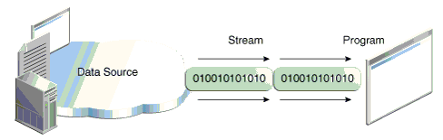
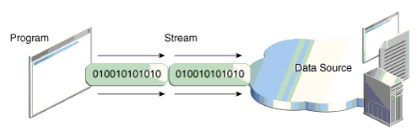
Streams (Contd…)
A program uses an input stream to read data from a source, one item at a time:
A program uses an output stream to write data to a destination, one item at time

Slide 28
Streams
Types of Streams
ByteOriented – In these stream,there is no notion of datatype or encoding scheme like Unicode.we can read data of any datatype with them as bytes are read
It is also referred as DataInputStream and DataOutputStream class in java.io package
CharacterOriented – In these stream, a character encoding scheme is used. Only one character are read through these type of streams.
It is also referred as Reader and Writer stream class in java.io. package

Slide 29
Character Oriented Streams
System Class and its stream
System | Description
System.in | In System Class,in is an object of input stream and automatically connected to standard input device or keyboard for accepting input
System.out | In System Class,out is an object of output stream and connected to standard output device or monitor or printer for displaying the output
System.err | In System Class,err is output stream and connected to standard output device or monitor or printer for displaying the error messages

Slide 30
Character Oriented Streams (Contd…)
Class | Description
java.io.InputStream | It stores information about the connection between an input device and the computer or program
java.io.InputStreamReader | It translates data bytes received from InputStream objects into a stream of characters
java.io.BufferedReader | It buffers the input received from an InputStreamReader object.It is used to improve the efficiency and buffering the data reduces the number of time the CPU has to interact with the device

Slide 31
Character Oriented Streams (Contd…)
Steps to read data using InputstreamReader
STEP I
InputStreamReader isr = new InputStreamReader(System.in);
STEP II
BufferedReader stdin = new BufferedReader(isr);
STEP III
System.out.println(“Enter your Name”);
STEP IV
String name = stdin.readLine();
STEP V
System.out.println(“Your Name = ” + name);

Slide 32
Character Oriented Streams (Contd…)
Guided practice for InputStreamReader
import java.io.*;
public class InputStreamDemo
{
public static void main(String a[])
{
try
{
InputStreamReader isr = new InputStreamReader(System.in);
BufferedReader stdin = new BufferedReader(isr);
System.out.println("Enter your Age");
String data = stdin.readLine();
int age=Integer.parseInt(data);
System.out.println("Your Age = " + age);
}
catch(Exception e)
{
System.out.println("Exception Occured " + e.toString());
}
}
}

Slide 33
Byte Oriented Streams
Note: If the file already exists, the existing file will be overwritten!
Class | Description
DataInputStream | It reads primitive java data types from an underlying input stream in a machine independent way
DataOutputStream | Its allows to write data that can be read by a data input stream
FileInputStream | It is used to read the contents of a file as a stream of bytes
FileOutputStream | It is used to write a data to file as a stream of bytes

Slide 34
Byte Oriented Streams (Contd…)
Guided practice for DataInputStream
import java.io.*
public class DataInputStreamDemo
{
public static void main(String[] as)
{
try
{
DataInputStream dis = new DataInputStream(System.in);
System.out.println("Enter First Number");
int a =Integer.parseInt(dis.readLine());
System.out.println("Enter Second Number");
int b = Integer.parseInt(dis.readLine());
int sum = a+b;
System.out.println("Sum is "+sum);
}
catch (Exception e)
{
e.printStackTrace();
}
}
}

Slide 35
Byte Oriented Streams (Contd…)
Guided practice for FileInputStream/FileOutputStream
FileInputStream fis = new FileInputStream("C:\\test111\\test.dat");
DataInputStream dis = new DataInputStream(fis);
int cityId1 = dis.readInt();
System.out.println("Id: " + cityId1);
String cityName1 = dis.readUTF();
System.out.println("Name: " + cityName1);
int cityPopulation1 = dis.readInt();
System.out.println("Population: " + cityPopulation1);
float cityTemperature1 = dis.readFloat();
System.out.println("Temperature: " + cityTemperature1);
int cityId2 = dis.readInt();
System.out.println("Id: " + cityId2);
String cityName2 = dis.readUTF();
System.out.println("Name: " + cityName2);
int cityPopulation2 = dis.readInt();
System.out.println("Population: " + cityPopulation2);
float cityTemperature2 = dis.readFloat();
System.out.println("Temperature: " + cityTemperature2);
}
catch (IOException e)
{
e.printStackTrace();
}
}
}
import java.io.*;
public class FileInputOutputStreamDemo
{
public static void main(String[] args)
{
int cityIdA = 1;
String cityNameA = "Green Lake City";
int cityPopulationA = 500000;
float cityTempA = 15.50f;
int cityIdB = 2;
String cityNameB = "Salt Lake City";
int cityPopulationB = 250000;
float cityTempB = 10.45f;
try {
FileOutputStream fos = new FileOutputStream("C:\\test111\\test.dat");
DataOutputStream dos = new DataOutputStream(fos);
dos.writeInt(cityIdA);
dos.writeUTF(cityNameA);
dos.writeInt(cityPopulationA);
dos.writeFloat(cityTempA);
dos.writeInt(cityIdB);
dos.writeUTF(cityNameB);
dos.writeInt(cityPopulationB);
dos.writeFloat(cityTempB);
dos.flush();
dos.close();
1
2

Slide 36
Util
Class | Description
java.util.Calendar | It provides static integer fields to display Calendar information
java.util.Date | It is used to display Date information
java.util.Scanner | It is used to accept data from the user through standard input device

Slide 37
Util (Contd…)
Guided practice for Calendar
import java.util.*;
public class CalendarDemo
{
public static void main(String[] args)
{
// create a calendar
Calendar cal = Calendar.getInstance();
// print current date
System.out.println("The current date is : " + cal.getTime());
// add 20 days to the calendar
cal.add(Calendar.DATE, 20);
System.out.println("20 days later: " + cal.getTime());
// subtract 2 months from the calendar
cal.add(Calendar.MONTH, -2);
System.out.println("2 months ago: " + cal.getTime());
// subtract 5 year from the calendar
cal.add(Calendar.YEAR, -5);
System.out.println("5 years ago: " + cal.getTime());
}
}

Slide 38
Calendar (Contd…)
Guided practice for Calendar
import java.util.*;
public class CalendarDemoTwo
{
public static void main(String[] args)
{
// create a calendar
Calendar cal = Calendar.getInstance();
// print current date
System.out.println("The current date is : " +
(cal.get(Calendar.MONTH) + 1) + "/" +
cal.get(Calendar.DATE) + "/" +
cal.get(Calendar.YEAR) + "/ " +
cal.get(Calendar.HOUR) + ":" +
cal.get(Calendar.MINUTE) + ":" +
cal.get(Calendar.SECOND) + ":" +
cal.get(Calendar.MILLISECOND));
}
}

Slide 39
Calendar (Contd…)
Guided practice for Date
import java.text.*;
import java.util.*;
public class DateTimeDemo
{
public static void main(String[] args)
{
DateFormat dateFormat = new SimpleDateFormat("yyyy/MM/dd HH:mm:ss");
//get current date time with Date()
Date date = new Date();
System.out.println(dateFormat.format(date));
//get current date time with Calendar()
Calendar cal = Calendar.getInstance();
System.out.println(dateFormat.format(cal.getTime()));
}
}

Slide 40
Util (Contd…)
Guided practice for Scanner
import java.util.*;
public class ScannerDemo
{
public static void main(String[] args)
{
Scanner in = new Scanner(System.in);
int integer;
long longInteger;
float realNumber;
double doubleReal;
String string1;
String string2;
System.out.println("Enter an integer");
integer = in.nextInt();
System.out.println("Enter a long integer");
longInteger = in.nextLong();
System.out.println("Enter a floating-point ");
realNumber = in.nextFloat();
System.out.println("Enter an double value");
doubleReal = in.nextDouble();
System.out.println("Enter a String Value");
string1 = in.next();
System.out.println("Here is what you entered: ");
System.out.println(integer + " " + longInteger + " " + realNumber +
" " + doubleReal + " " + string1);
}
}

Slide 41
Surprise
Open a Image using Java Program
~~~~~~~~~~~~~~~~~~~~~~~~~~~~~~
import java.util.*;
import java.io.*;
public class Test
{
public static void main(String args[]) throws IOException
{
Runtime rs = Runtime.getRuntime();
String imageExePath=“rundll32.exe C:\\WINDOWS\\System32\\shimgvw.dll,ImageView_Fullscreen ”;
rs.exec(imageExePath + “C:\\Users\\Isha\\Desktop\\challenges.jpg");
}
}

Slide 42
Surprise
View package info in command prompt
~~~~~~~~~~~~~~~~~~~~~~~~~~~~~~
Open a command prompt
enter javap java.lang.String
System will display the list of information
Enter javap –c java.lang.String
System will display disassembly code for class

Slide 43

Summary
Package
It is mechanism for organizing java classes
Exception
Try..catch
Try..catch..finally
Types of Error
Compilation Error
Runtime Error
Wrapper Class
Types of Wrapper cladd
String
It is immutable
StringBuffer
It is mutable

Slide 44
Summary
Stream
CharacterOriented
ByteOriented
Util
Calendar
Date
Scanner

Slide 45

FAQs

